Slide 1

Food Truck Ordering
Jaden Wattley, Sean Staley,
10/16/2025

Slide 2

Project Overview
We're improving the food truck ordering flow by letting users build their meal, send it as a ticket with an order number, and have it pop up on the employee side for quick fulfillment.
We're using HTML for the frontend interface and C++ for backend functionality, based on the team's familiarity and strengths with each language.
Our implementation bridges frontend and backend through a lightweight workflow, showcasing how simple tools can solve real-world problems when paired with thoughtful design and team collaboration.

Slide 3

Need Analysis
See
See the food truck's menu and prices
Order
Place and customize orders
View
View food truck location
Receive
Receive incoming orders
Manage
Manage current orders

Slide 4
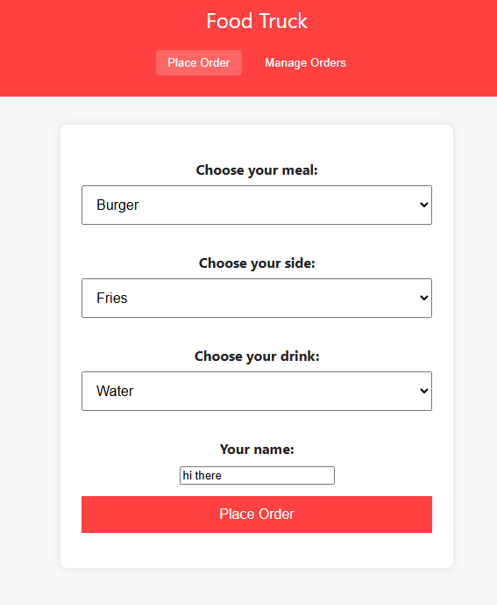
Software Design - FR1
We have a semi working form submission page.

Slide 5
Software Design - FR2

Slide 6
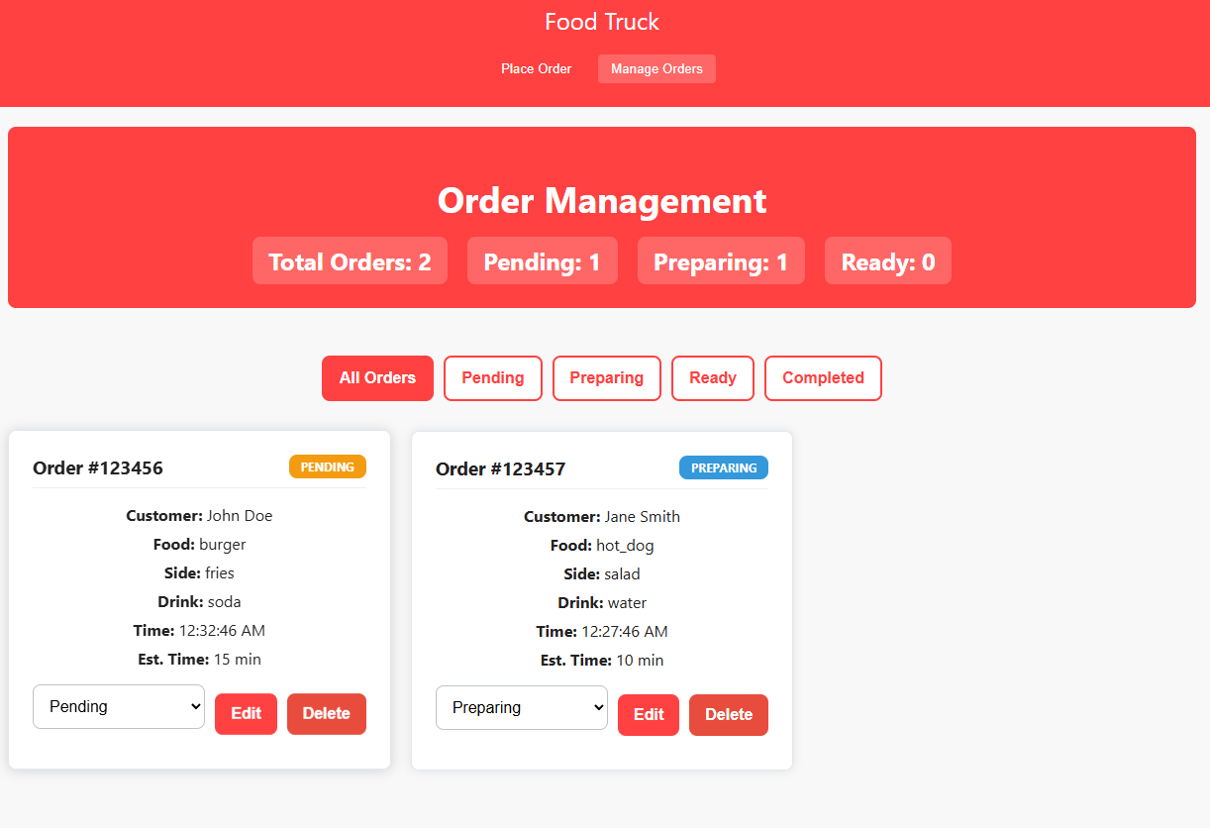
Software Design - FR5

Slide 7
Software Design - NFR3

Slide 8
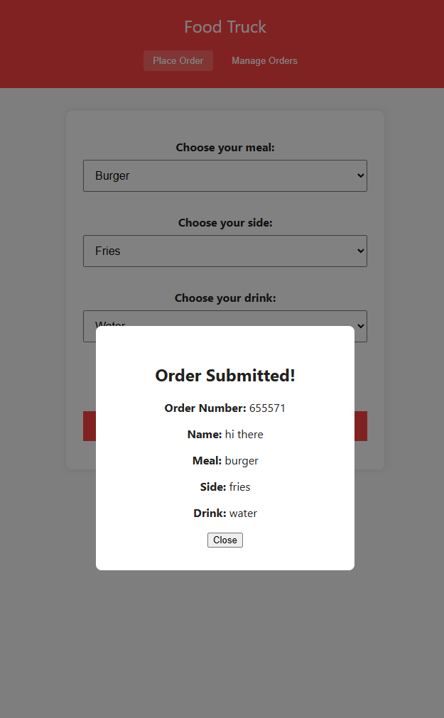
Software Design - NFR4

Slide 9
Risk Analysis

Slide 10
Potential ethical issues

Slide 11

Team Roles
Sean Staley – Project Manager / Frontend Engineer
Jaden Wattley – Backend Engineer / Product Engineer
Robert Wickliffe – Full Stack Dev
Connor Raque – None

